Slide 1

RNA-seq Analysis in R – DESeq2
Brendan Jeffrey, Ph.D.
September 12, 2019
brendan.jeffrey@nih.gov
Bioinformatics and Computational Biosciences Branch - BCBB

Slide 2
Purpose of This Course
Introduction to RNA-seq
An introduction to computational tools used for processing and analyzing RNA-seq data – heavy on the R

Slide 3
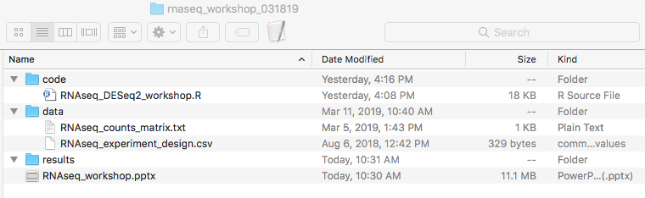
Course Materials
Course materials can be accessed one OneDrive

Slide 4
Introduction – What is RNA-seq
RNA sequencing uses next-generation sequencing to reveal presence and quantity of RNA in a biological sample at a given moment in time

Slide 5
Introduction – Why Sequence RNA
Qualitative - Annotation
Transcriptome assembly
Novel gene finding
Defining Exon/Intron boundaries
SNP finding
Quantitative
Functional studies
Differential gene expression
Alternative splicing

Slide 6
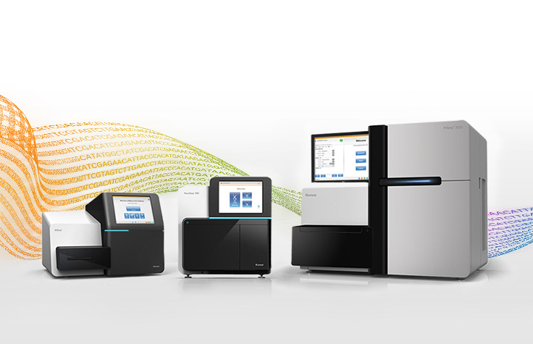
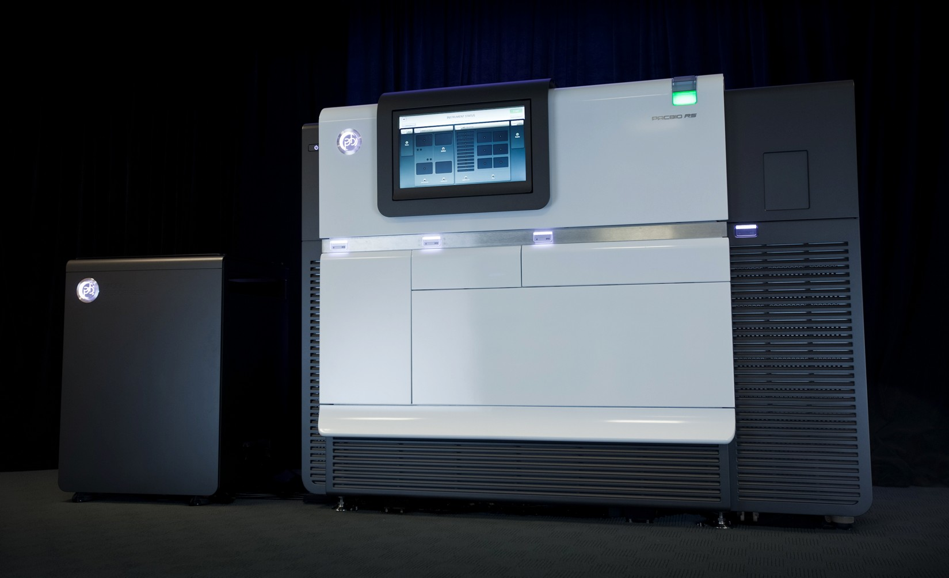
RNA-seq – Experiment Workflow
Design
Experiment
Experiment designed to address your question
RNA
Preparation
Isolate and purify RNA
Prepare
Libraries
Convert RNA to cDNA
add adaptors,
multiplex barcodes
Sequence
Sequence cDNA using sequencing platform -
Illumina / Pac Bio
Analysis
Analyzing sequenced short reads

Slide 7
RNA-seq – Experiment Workflow
Design
Experiment
Qualitative/Annotation – analyze RNA-seq reads to identify genes, architecture
RNA
Preparation
Depth of coverage is important versus replicates
Prepare
Libraries
Sequence
Library prep methods important to get even coverage across entire transcript
SMARTer system - clontech
Analysis

Slide 8
RNA-seq – Experiment Workflow
Design
Experiment
Differential Gene Expression
RNA
Preparation
DGE experiments designed to accurately measure both the counts of each gene (coverage) and the variances that are associated with those counts (replicates)
Prepare
Libraries
Sequence
Biological replicates >> Technical replicates
Analysis
Biometry: The Principles and Practices of Statistics in Biological Research – Sokal and Rohlf

Slide 9
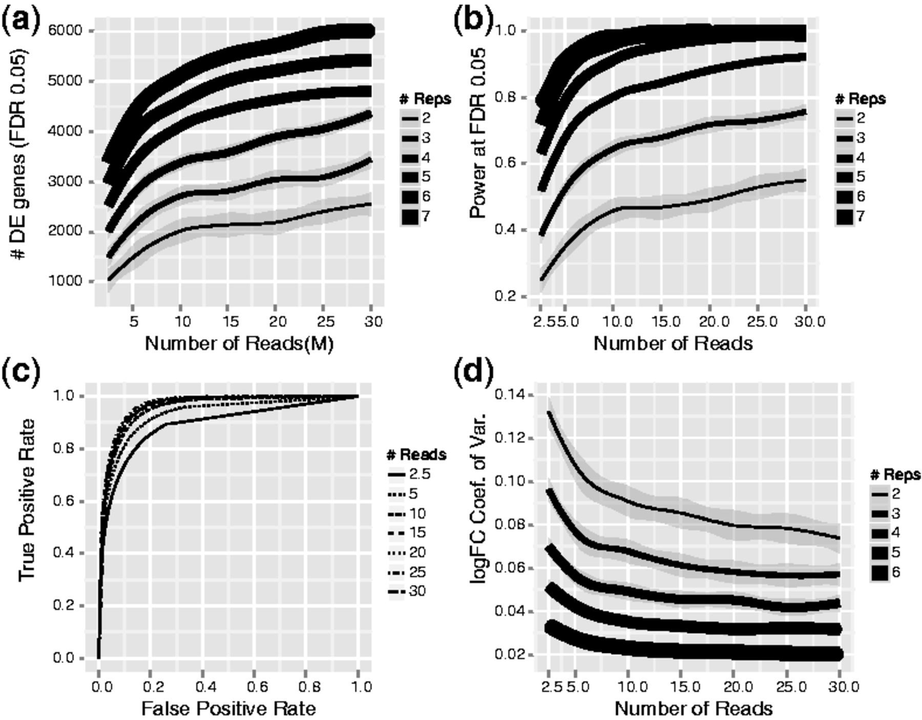
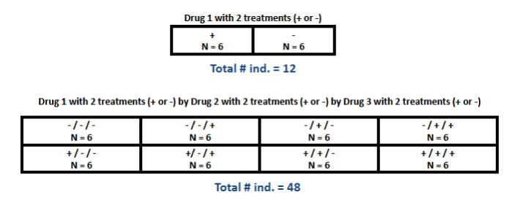
RNA-seq – Experiment Workflow
Design
Experiment
RNA
Preparation
Prepare
Libraries
Sequence
Sample treatment/processing randomization
Analysis

Slide 10
RNA-seq – Experiment Workflow
Design
Experiment
RNA
Preparation
We need more power!
Prepare
Libraries
Scotty
Sequence
Analysis

Slide 11
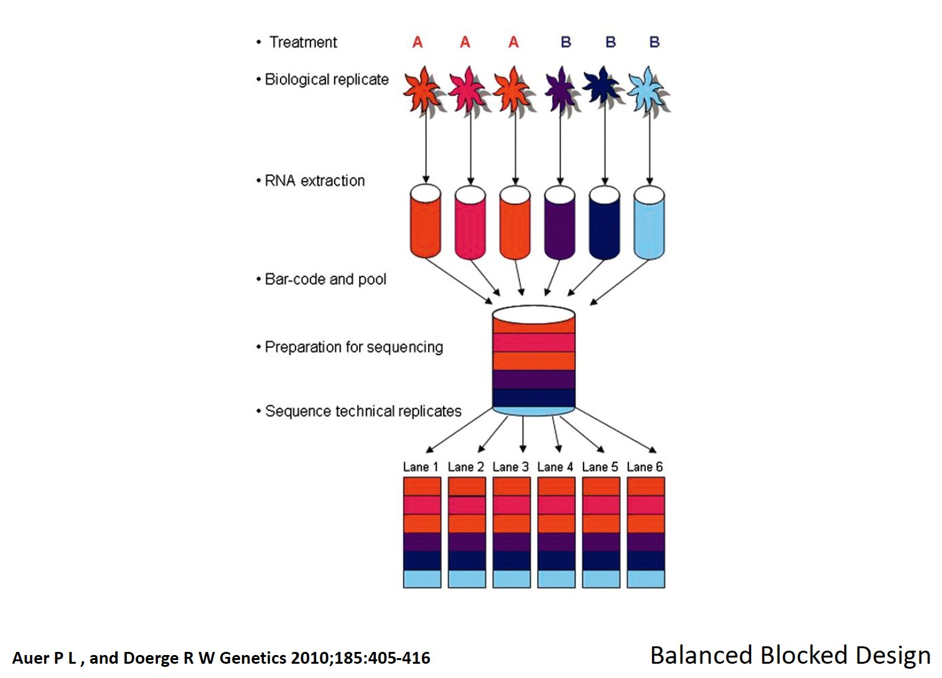
RNA-seq – Experiment Workflow
Design
Experiment
Multiplex and pool when sequencing
RNA
Preparation
Prepare
Libraries
Balanced Blocked Design
Sequence
Analysis

Slide 12
RNA-seq – Sequence Quality Control
Several million reads generated - Fastq format
Design
Experiment
@M03264:1:000000000-AB9MU:1:1101:9844:1771 1:N:0
TATTCTGTGACTAGATTTTTTGAGAATAAATCAGAATACAATTCATTCTTTGATATACAAGTATCGCCCAT
+
CGGGGGGGGGGGGGGGGGGGGGGGGGGGGGGGGFC<FCFFDGGGGGGGGGGGCGFGGGFFFGGGGGGGGGG
RNA
Preparation
Prepare
Libraries
Sequence
Analysis

Slide 13
RNA-seq – Sequence Quality Control
Several million reads generated - Fastq format
Design
Experiment
@M03264:1:000000000-AB9MU:1:1101:9844:1771 1:N:0:5
TATTCTGTGACTAGATTTTTTGAGAATAAATCAGAATACAATTCATTCTTTGATATACAAGTATCGCCCAT
+
CGGGGGGGGGGGGGGGGGGGGGGGGGGGGGGGGFC<FCFFDGGGGGGGGGGGCGFGGGFFFGGGGGGGGGG
RNA
Preparation
Quality Score | Probability of Incorrect Base Call | Inferred Base Call Accuracy
10 (Q10) | 1 in 10 | 90%
20 (Q20) | 1 in 100 | 99%
30 (Q30) | 1 in 1000 | 99.9%
Prepare
Libraries
Sequence
Analysis

Slide 14
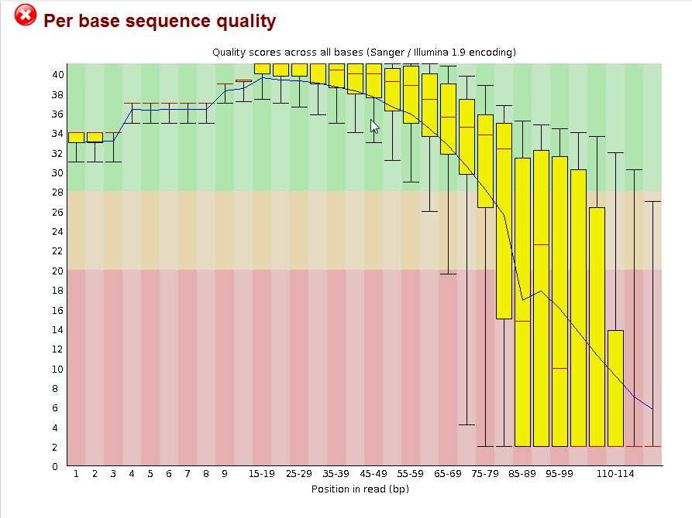
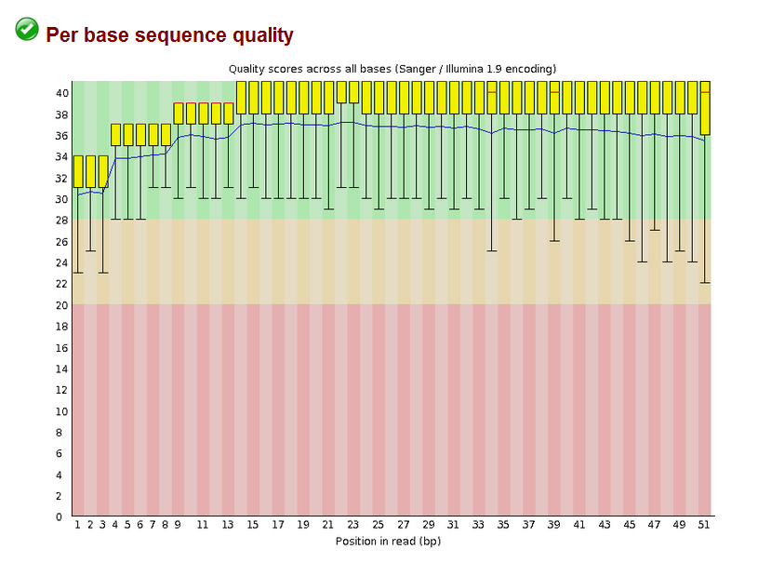
RNA-seq – Sequence Quality Control
Design
Experiment
RNA
Preparation
Prepare
Libraries
Sequence
Read QC overview with FastQC
Illumina adaptor removal, quality trimming of reads
Analysis
Trimmomatic, Sickle, FASTX-Toolkit, Stacks

Slide 15
RNA-seq – Mapping Reads
Design
Experiment
Bowtie2 – great general use
Splice aware?
RNA
Preparation
HISAT2
BWA-MEM
STAR – gene counts as output
Prepare
Libraries
Pseudoalignment – very fast
Sequence
Kallisto
Salmon
Analysis

Slide 16
RNA-seq – Alignment files – SAM/BAM
Design
Experiment
SAM/BAM format
read_42 99 ref_genome 155 42 75M = 162 80 ATTTTGTTTT <CCCCGGGFF AS:i:0 XN:i:0
RNA
Preparation
Prepare
Libraries
Sequence
Analysis

Slide 17
RNA-seq – General Analysis Workflow
Design
Experiment
Compute resources - NIH NIAID compute cluster
RNA
Preparation
NIH NIAID Locus
Prepare
Libraries
Request user account via NIAID HPC support
NIAIDHPCSUPPORT@niaid.nih.gov
Sequence
Analysis

Slide 18
RNA-seq – General Analysis Workflow
Prokaryote/Eukaryote – gene level
Design
Experiment
Condition A
Condition B
RNA
Preparation
QC trimmed reads
QC trimmed reads
bowtie2
reference.fa
bwa-mem
STAR
Prepare
Libraries
MappedA.bam
MappedB.bam
HTSeq
Kallisto
annotation.gtf
SummmarizeOverlaps
Sequence
Counts_A
Counts_B
Counts_matrix
DESeq2
DESeq2 manuscript
Analysis
Differentials

Slide 19
RNA-seq – General Analysis Workflow
Eukaryote – transcript level
Design
Experiment
Condition A
Condition B
QC trimmed reads
QC trimmed reads
RNA
Preparation
HISAT2
reference.fa
MappedA.bam
MappedB.bam
Stringtie
annotation.gtf
Prepare
Libraries
Assembled transcripts A
Assembled transcripts B
Stringtie
Final transcript assembly
Sequence
MappedA.bam
MappedB.bam
Counts matrix
Analysis
Tuxedo suite
Ballgown
EBseq
Differentials

Slide 20
RNA-seq – Differential Gene Expression
Design
Experiment
Hands on RNA-seq analysis with R
RNA
Preparation
R is a free software environment for statistical computing and graphics
Prepare
Libraries
Rstudio is an integrated development environment (IDE) for R
Sequence
Similar DESeq2 tutorial here
Analysis

Slide 21
RNA-seq – Differential Gene Expression w/ DESeq2
Design
Experiment
Simplest form, asking if ‘count’ between two treatments for a gene is not zero, reject null hypothesis
RNA
Preparation
DESeq2 uses a generalized linear model where read counts are modeled using a Negative Binomial Distribution
mean and variance are not equal (poisson)
NB uses a gene-specific dispersion parameter
Prepare
Libraries
Sequence
Wald test - estimated standard error of a log2 fold change to test if it is equal to zero
Analysis
Likelihood Ratio Test (LRT) - useful for testing multiple terms at once. Conceptually similar to ANOVA

Slide 22
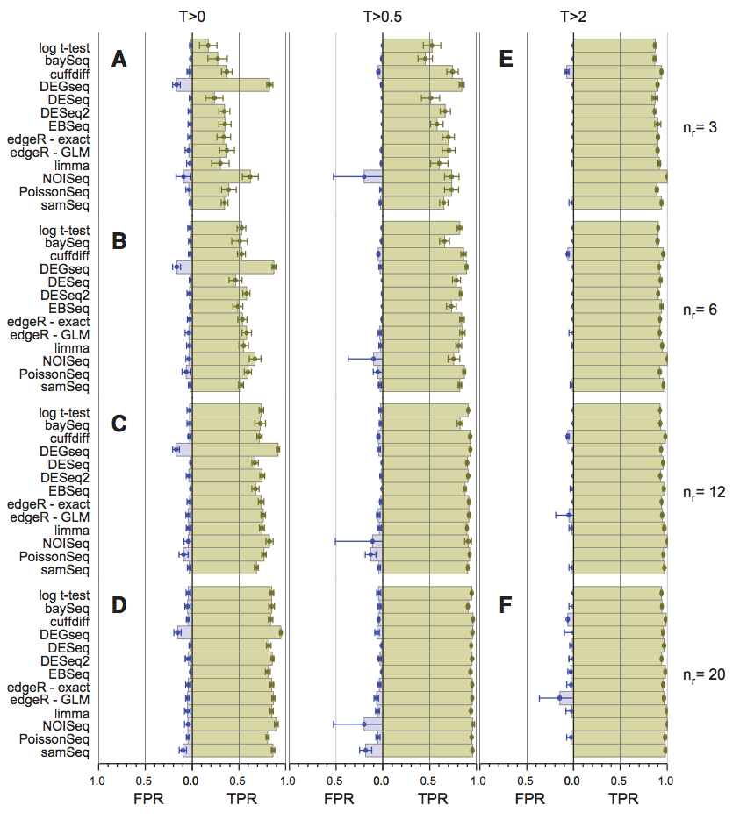
RNA-seq – Differential Gene Expression Tool Choice
Which tool should I use? Try several and compare
Design
Experiment
Schurch et al.
Sahraeian et al.
RNA
Preparation
Prepare
Libraries
Sequence
Analysis

Slide 23
Thank You!

